Slide 1
Optimization of Target’s Queue Management Using Simulation Modeling
Raheela Charania
Anmol Anchala
Emmanuel Wediko
Notes:
Good morning Dr. Ahmadi and my fellow classmates!
My name is Raheela Charania and along with me are ____ and ____.
Today we’ll be presenting our project on Self-checkout vs. Cashier: How do we get out of Target faster?

Slide 2
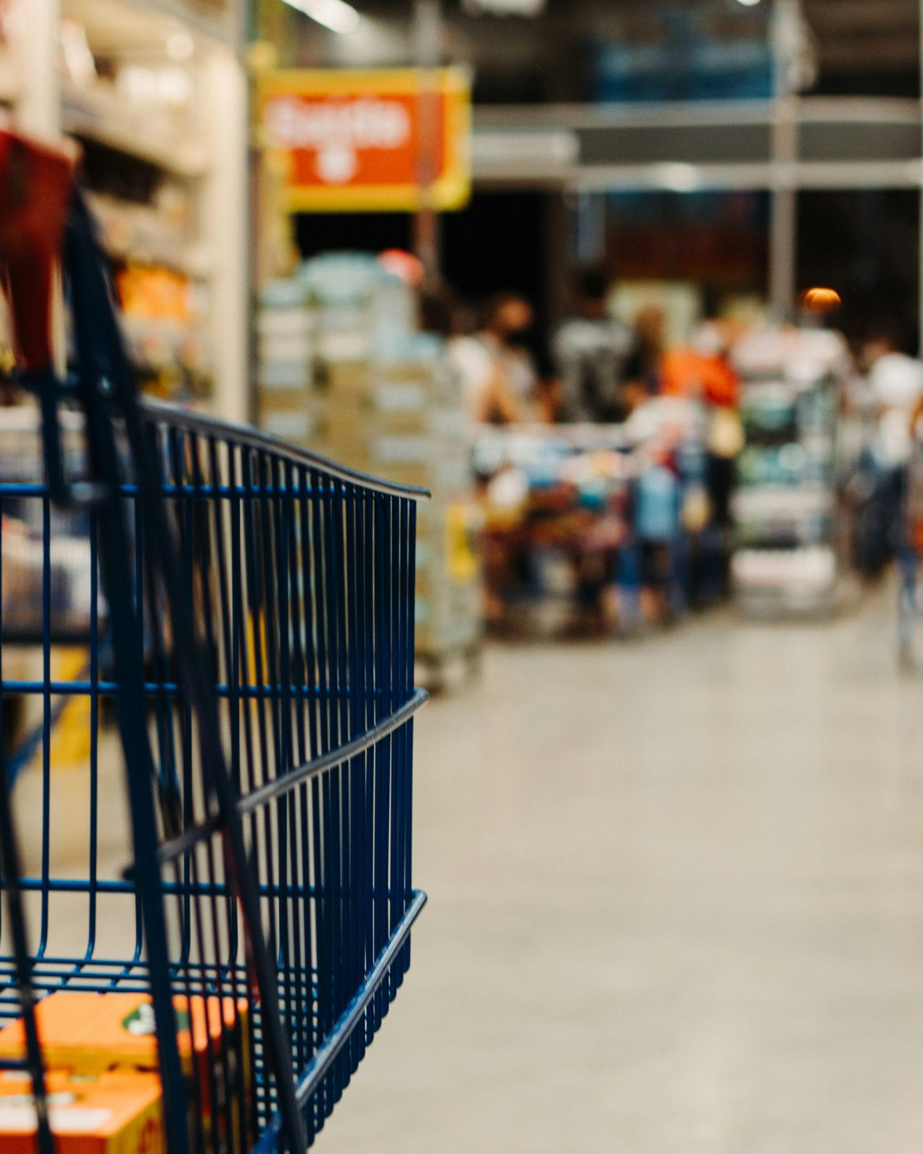
Motivation
U.S. Dept of Agriculture Statistics (2014-2017)⁴
Business Problem
Long wait times
Low utilization of cashiers
Methodology
Lanes with cashier vs. Self-checkout lanes
Photo by Eduardo Soares on Unsplash²
Notes:
Raise of hands, who goes grocery shopping
Routine
Buy necessities, food, or my personal favorite, chocolate
US Dept of agriculture, Americans average 48 mins & 1.6 times/ week.
Almost 80 mins!
All have busy lives! Our business problem comes into play
Long wait lines and underutilization of our cashiers,
Customers are unhappy and we’re losing money
Find a Solution - We looked at the difference in time between self check out lanes and lanes with cashiers to see where we can get the least waiting times for our customers at Target.
Came up with a model to decrease wait times & less idle cashiers
Leading to Happier customers and of course more revenue for us.
Let’s take a look!
Anmol’s turn
[very enthusiastically] Can i see a raise of hands who goes to get groceries?? Great, I mean at this point, it’s a routine. Each week we all go to the grocery store to get necessities for our homes, whether it’s food, napkins, or my personal favorite- chocolate! And According to the USDA, on average, Americans spend about 48 minutes grocery shopping about 1.6 times a week. That’s about 70 minutes! Now, we all have busy lives and this is where our business problem comes in. Our team looked at the time spend in line waiting for the cashier and checking out there as compared with the time in the self checkout lanes and checking out. So, let’s take a look at our model and see what we found.
Stat:
On an average day in 2014-17, more women shopped for groceries than did men (17 percent versus 10 percent), and women grocery shoppers spent more time shopping than did men shoppers (47.6 versus 43.3 minutes).
https://www.ers.usda.gov/amber-waves/2020/april/more-americans-spend-more-time-in-food-related-activities-than-a-decade-ago/
https://www.nasdaq.com/articles/the-average-american-spends-this-much-driving-to-the-grocery-store

Slide 3
Process Flow Diagram: Cashier
Cashier Queue 1
Cashier 1
Cashier 2
End
Customer
Cashier Queue 2
Cashier Queue 3
Cashier 3
Notes:
Anmol

Slide 4
Process Flow Diagram: Self check-out
Self-checkout Kiosk 1
Self-checkout Kiosk 2
Self-checkout Queue
End
Customer
Self-checkout Kiosk 3
Self-checkout Kiosk 4
Notes:
Anmol

Slide 5
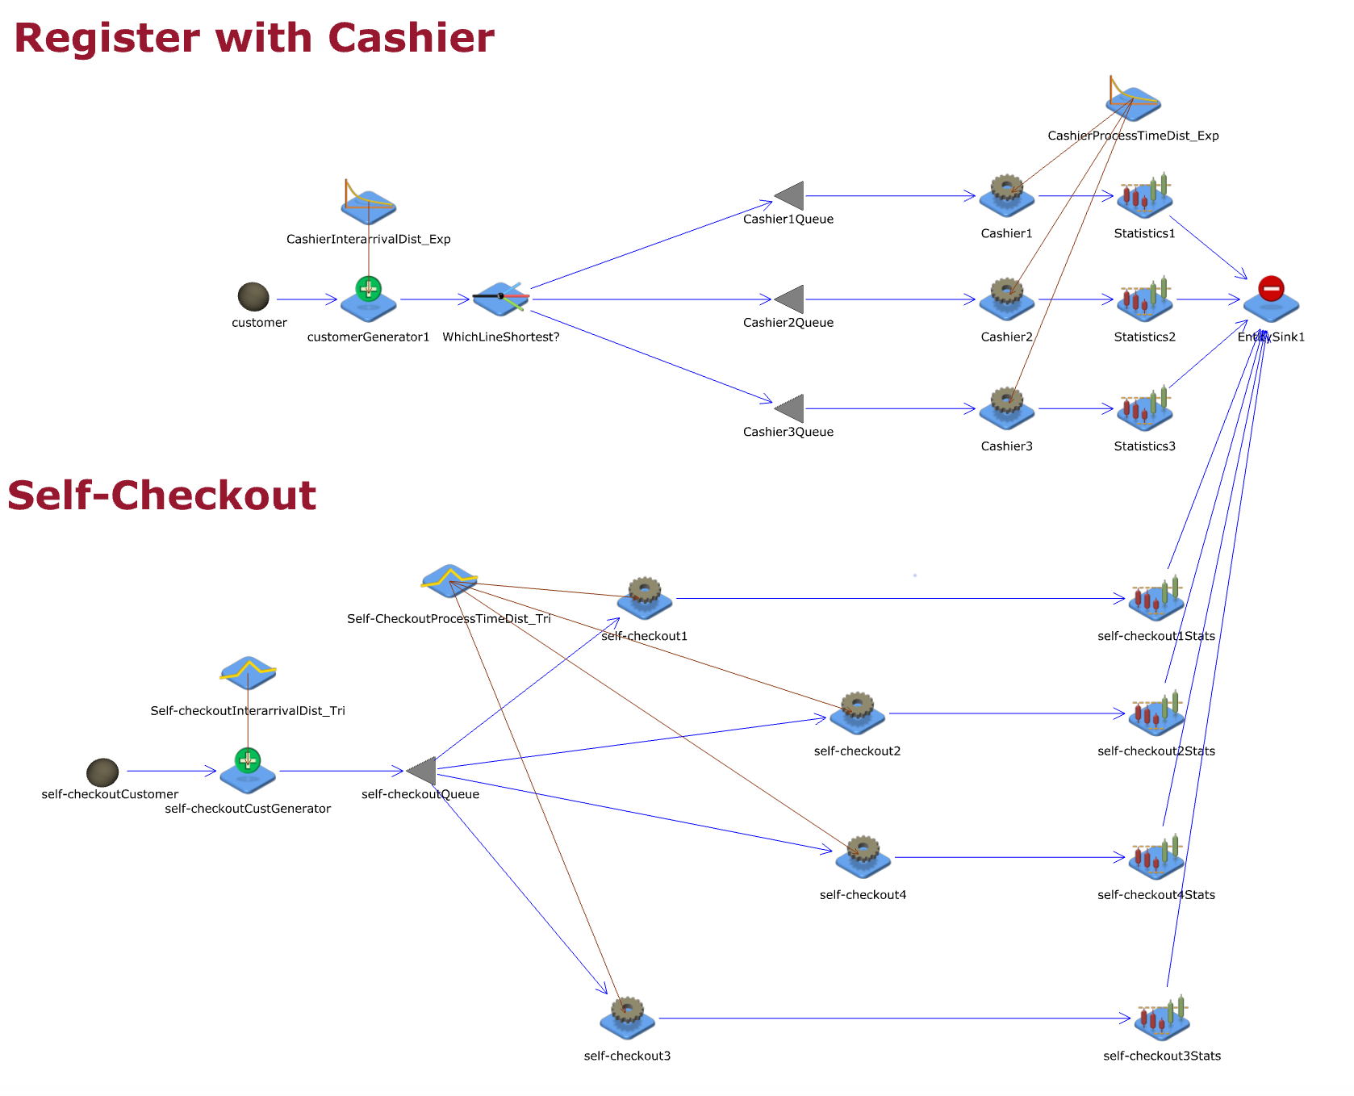
10 replications
Duration?? Where do we find this?
10 repetitions
Notes:
“And this is our model on JaamSim”
Anmol
We collected data on 50 customers for both the wait times in both the self check out and the cashier lane as well as the time spent at the register for each.
For these data, we fit a distribution model and created a simulation on JaamSim. We ran this for 10 replications and found a few important details
came out with the following results

Slide 6
Assumptions
Customer Behavior
Sample Size Representation
Checkout Station Capacities
No Queue Reneging

Slide 7
Performance
Number of Customers Processed at Cashier 1 | 1416
Number of Customers Processed at Cashier 2 | 31
Number of Customers Processed at Cashier 3 | 0
Number of Customers Processed at Self-Checkout 1 | 38
Number of Customers Processed at Self-Checkout 2 | 38
Number of Customers Processed at Self-Checkout 3 | 45
Number of Customers Processed at Self-Checkout 4 | 42
PERFORMANCE METRIC | VALUE
Cashier 1 Utilization Rate | 58.91%
Cashier 2 Utilization Rate | 1.52%
Cashier 3 Utilization Rate | 0%
Self – Checkout 1 Utilization Rate | 99.70%
Self – Checkout 2 Utilization Rate | 99.34%
Self – Checkout 3 Utilization Rate | 96.47%
Self – Checkout 4 Utilization Rate | 97.80%
Notes:
Emmanuel

Slide 8
Data collection and statistical analysis (Time going before Kiosk)
Kiosk line | Sum of Squares Error | AIC | Ks_pvalue
Triangular | 0.120372 | 793.752493 | 0.268487
Beta | 0.121401 | 801.952881 | 0.61042
Exponential | 0.126477 | 832.418659 | 0.131329
Normal | 0.129752 | 831.663986 | 0.134881
Uniform | 0.135595 | 756.750998 | 0.002482
Cashier line | Sum of Squares Error | AIC | Ks_pvalue
Exponential | 0.000936 | 1619.161243 | 8.376714e-01
Beta | 0.000961 | 1468.209269 | 1.774109e-01
Normal | 0.001450 | 1943.007726 | 1.385572e-02
Triangular | 0.001606 | 1313.275960 | 1.063462e-11
Uniform | 0.001985 | 71262.52112 | 1.660639e-20
Waiting line - Kiosk
Waiting line - Cashier
Notes:
We looked at the output and went with the model that had the best combination of high p value, low aic and lowest SSE.
The Akaike information criterion (AIC) is an estimator of prediction error and thereby relative quality of statistical models for a given set of data.
Figure out average amount spent per customer and calculate revenue based on total amount gained.

Slide 9
Data collection and statistical analysis at register/kiosk
Kiosk Station | Sum of Squares Error | AIC | Ks_pvalue
Beta | 0.004696 | 1219.545758 | 8.462428e-01
Triangular | 0.005197 | 1128.679877 | 2.809947e-03
Normal | 0.005237 | 1286.48934 | 8.041126e-02
Exponential | 0.005437 | 1194.032254 | 1.510906e-01
Uniform | 0.006514 | 1082.961733 | 5.897386e-09
Cashier | Sum of Squares Error | AIC | Ks_pvalue
Beta | 0.000738 | 1704.890062 | 2.251890e-01
Exponential | 0.001133 | 1550.192528 | 1.957437e-03
Normal | 0.001143 | 1962.619522 | 5.239516e-03
Triangular | 0.001436 | 1303.908673 | 1.494726e-13
Uniform | 0.001832 | 1254.072254 | 6.418196e-24
Service time - Kiosk
Service time - Cashier
Notes:
Figure out average amount spent per customer and calculate revenue based on total amount gained.

Slide 10
Current Model
New Model
# of Customers Processed at Cashier 1 | 1416
# of Customers Processed at Cashier 2 | 31
# of Customers Processed at Cashier 3 | 0
# of Customers Processed at Self-Checkout 1 | 38
# of Customers Processed at Self-Checkout 2 | 39
# of Customers Processed at Self-Checkout 3 | 45
# of Customers Processed at Self-Checkout 4 | 42
# of Customers Processed at Cashier 1 | 1416
# of Customers Processed at Cashier 2 | 31
# of Customers Processed at Self-Checkout 1 | 39
# of Customers Processed at Self-Checkout 2 | 46
# of Customers Processed at Self-Checkout 3 | 30
# of Customers Processed at Self-Checkout 4 | 33
# of Customers Processed at Self-Checkout 5 | 27
# of Customers Processed at Self-Checkout 6 | 25
Potential Revenue (Based on consumer’s avg weekly Target run) | $4,076.80
Notes:
Currently we have 3 cashiers and 4 self checkout kiosks. Since the utilization rate of cashier 3 is 0%, we plan on removing this 3rd cashier
and adding two additional self checkout stations.
Raheela
We collected data on 50 customers for both the wait times in both the self check out and the cashier lane as well as the time spent at the register for each.
For these data, we fit a distribution model and created a simulation on JaamSim. We ran this for 10 replications and came out with the following results
Average wage at target- then price of inserting kiosk then figure out how many months to breakeven.

Slide 11
Conclusion
Recommendation
Kiosk machines are utilized at 100%
Lanes are underutilized
Add more kiosk machines
Remove cashier lanes
Collect more data over a longer period of time (multiple days & multiple times of the day)
Notes:
Depending on rush hour data might vary

Slide 12
References
Mohammad, Y. (2024, September 28). Target statistics: The key data and Numbers (2024 updated). Contimod. https://www.contimod.com/target-statistics/#:~:text=Each%20day%2C%20Target%20generates%20approximately,approximately%2021%20visits%20per%20year
Soares, E. (2020). blue shopping cart on street during daytime. Unsplash.com. Retrieved October 7, 2024, from https://unsplash.com/photos/blue-shopping-cart-on-street-during-daytime-QsYXYSwV3NU?utm_content=creditCopyText&utm_medium=referral&utm_source=unsplash.
Tretheway, C. (2024, January 3). More Americans spend more time in food-related activities than a decade ago. USDA ERS - More Americans Spend More Time in Food-Related Activities Than a Decade Ago. https://www.ers.usda.gov/amber-waves/2020/april/more-americans-spend-more-time-in-food-related-activities-than-a-decade-ago/
Zeballos, E. (2020, April 6). More Americans spend more time in food-related activities than a decade ago. USDA Economic Research Service. https://www.ers.usda.gov/amber-waves/2020/april/more-americans-spend-more-time-in-food-related-activities-than-a-decade-ago/

Slide 13
Thank You & Questions

